Slide 1
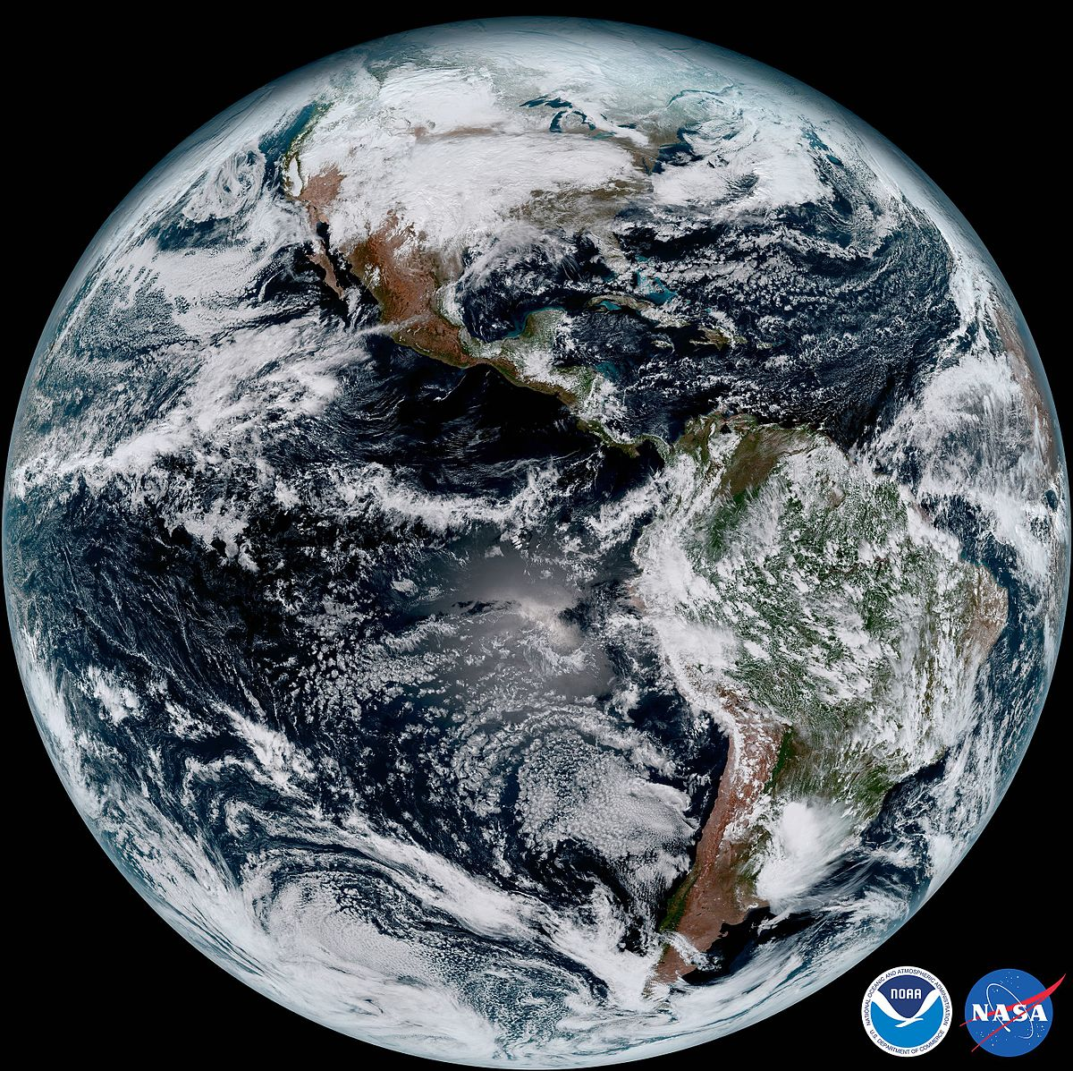
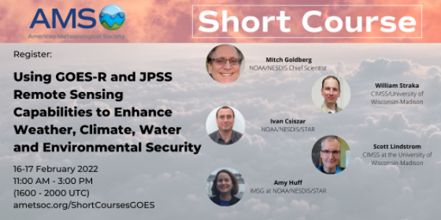


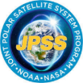


Using GOES-R and JPSS Remote Sensing Capabilities to Enhance
Weather, Climate, Water and Environmental Security
Welcome to Day 2!
February 17, 2022
11:00 AM - 3:00 PM Eastern Time (Virtual)
Objective:
To learn to how to access, use and apply GOES-R and JPSS satellite data and products by exploring operational scenarios that address forecasting challenges and improve data driven decision making to mitigate the impact of environmental disasters
Remember this is hands-on course

Slide 2


Using GOES-R and JPSS Remote Sensing Capabilities to Enhance
Weather, Climate, Water and Environmental Security
Reminder:
Add your questions in the chat box and/or go to “reactions” to raise and lower your hand

Slide 3
Using GOES-R and JPSS Remote Sensing Capabilities to Enhance
Weather, Climate, Water and Environmental Security
Day 2
Time (ET) | Session Titles
11:00-12:00 | Detection and Characterization of Fires & Smoke from ABI and VIIRS Ivan Csiszar, Branch Chief, Satellite Meteorology and Climatology Division, NOAA/NESDIS/STAR
12:00-12:10 | Break: 10 minutes
12:10-12:30 | Introduction to ABI and VIIRS Level 2 Data Files Amy Huff, IMSG at NOAA/NESDIS/STAR
12:30-13:00 | Download ABI and VIIRS Level 2 Data Files from AWS Amy Huff, IMSG at NOAA/NESDIS/STAR
13:00-13:40 | Open and Explore the Contents of ABI and VIIRS Level 2 Data Files Amy Huff, IMSG at NOAA/NESDIS/STAR

Slide 4
Using GOES-R and JPSS Remote Sensing Capabilities to Enhance
Weather, Climate, Water and Environmental Security
Day 2 of 2 continued
Time (ET) | Session Titles
13:40-13:50 | Break: 10 minutes
13:50-14:30 | Process and Visualize ABI and VIIRS Level 2 Fire Products for the Caldor Fire Amy Huff, IMSG at NOAA/NESDIS/STAR
14:30-14:50 | Linking the Topics - Flash flooding from burn scars, how to mitigate different scales of data All instructors
14:50-15:00 | Satellite launches and Wrap Up

Slide 5
Using GOES-R and JPSS Remote Sensing Capabilities to Enhance
Weather, Climate, Water and Environmental Security
Dr. Ivan Csiszar is the Branch Chief of the Environmental Monitoring Branch of the Satellite Meteorology and Climatology Division at NOAA/NESDIS Center for Satellite Applications and Research (STAR). He currently works on land surface observations from NOAA’s new generation environmental satellites, with a particular focus on active fire mapping and monitoring from JPSS Visible Infrared Imaging Radiometer Suite (VIIRS) and GOES-R Advanced Baseline Imager (ABI) measurements.
Dr. Amy K. Huff is a Senior Research Scientist at I.M. Systems Group, a contractor for the NOAA NESDIS Center for Satellite Applications and Research (STAR). Currently, Dr. Huff is the outreach representative for STAR's aerosol and atmospheric composition science team. She acts as a liaison to satellite data end users and promotes utilization of satellite products through training sessions and social media (Twitter: @AerosolWatch). Her research involves air quality applications of aerosol and trace gas observations from geostationary and polar-orbiting satellites

Slide 6
Using GOES-R and JPSS Remote Sensing Capabilities to Enhance
Weather, Climate, Water and Environmental Security
CIRA VISIT Website for Retrieving Presentation Slides: https://rammb.cira.colostate.edu/training/visit/links_and_tutorials/2022_AMS_Satellite_Short_Course.asp
Upcoming Launches:
GOES–T: 1 March 2022 (virtual, Kennedy Space Center)
JPSS-2: 30 September (Vandenburg AFB)
Future AMS Satellite Applications Short Courses:
AMS Committee on Satellite Meteorology, Oceanography and Climatology (SatMOC) virtual training on satellite data applications – 4 topics to be covered in May, June, and July
AMS Short Course on GOES-R and JPSS at the Collective Madison Meeting (CMM) in Madison, WI on 7 August
  Call for Papers deadline 14 April 2022

Slide 7
Using GOES-R and JPSS Remote Sensing Capabilities to Enhance
Weather, Climate, Water and Environmental Security
Upcoming GOES-T Launch 1 March 2022 (virtual, Kennedy Space Center)
Can register to be a virtual guest through Eventbrite at: https://www.eventbrite.com/e/geostationary-operational-environmental-satellite-t-goes-t-launch-tickets-225445091337
  Virtual guests for the GOES-T launch will receive behind-the-scenes videos, stay informed with up-to-date resources, and will receive a stamp for their virtual guest passport following launch. Whether registered as a virtual guest or not, the NASA TV link is where to watch the launch coverage
The NASA TV link will provide coverage starting at 4:00 p.m. EST on March 1, NASA Live: Official Stream of NASA-TV: https://www.youtube.com/watch?v=21X5lGlDOfg
The NEDIS website will also have the NASA live coverage embedded at https://www.nesdis.noaa.gov/next-generation/goes-t-launch.

